Slide 1

Matrimonial Website
By-Ashima Yadav & Dia Bansal
2010991503 2010991533

Slide 2
Project Brief
We have made our project in react. It includes 11 components namely Navbar, Register, Login, Subscription, Match, Cards, Boysprofile, Girlsprofile, Gateway, BProfile & GProfile. We have used routing, hooks etc. in our project.

Slide 3
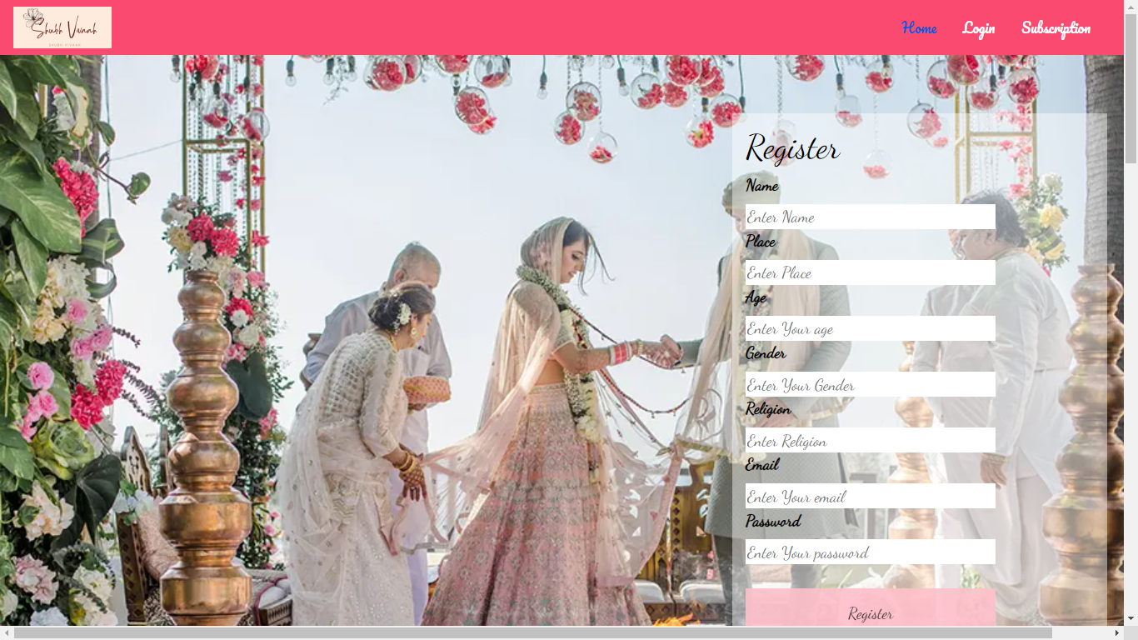
Main Page
It includes a register form for the candidate to register his/her profile details. And navbar includes home , login button to display login page and subscription to select package.

Slide 4
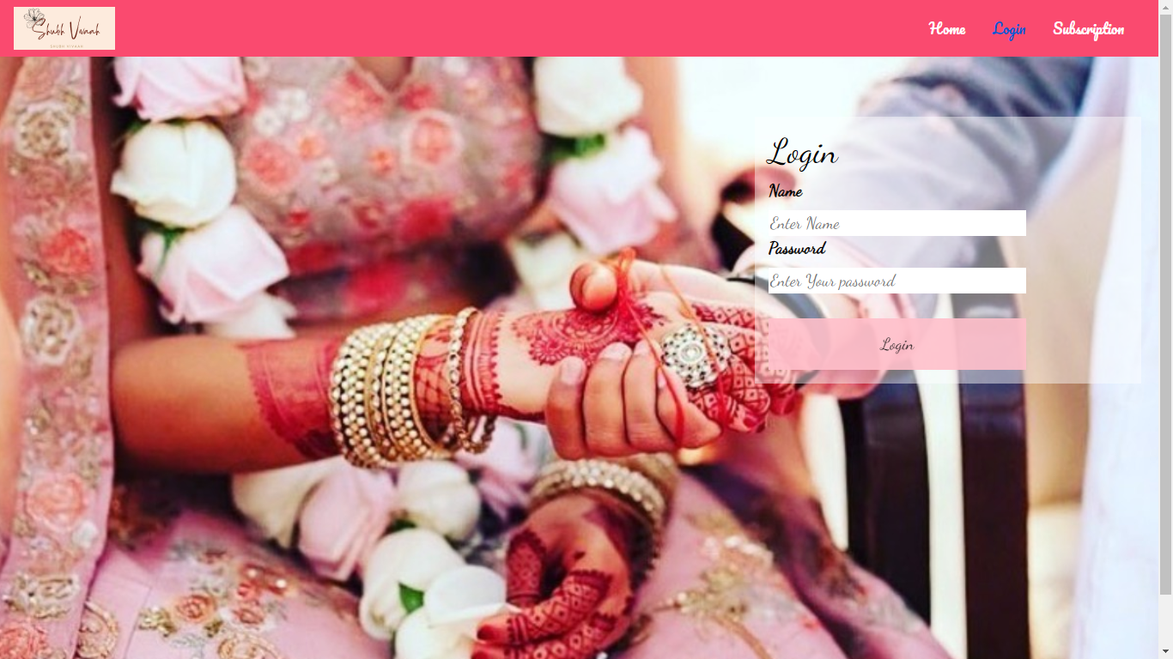
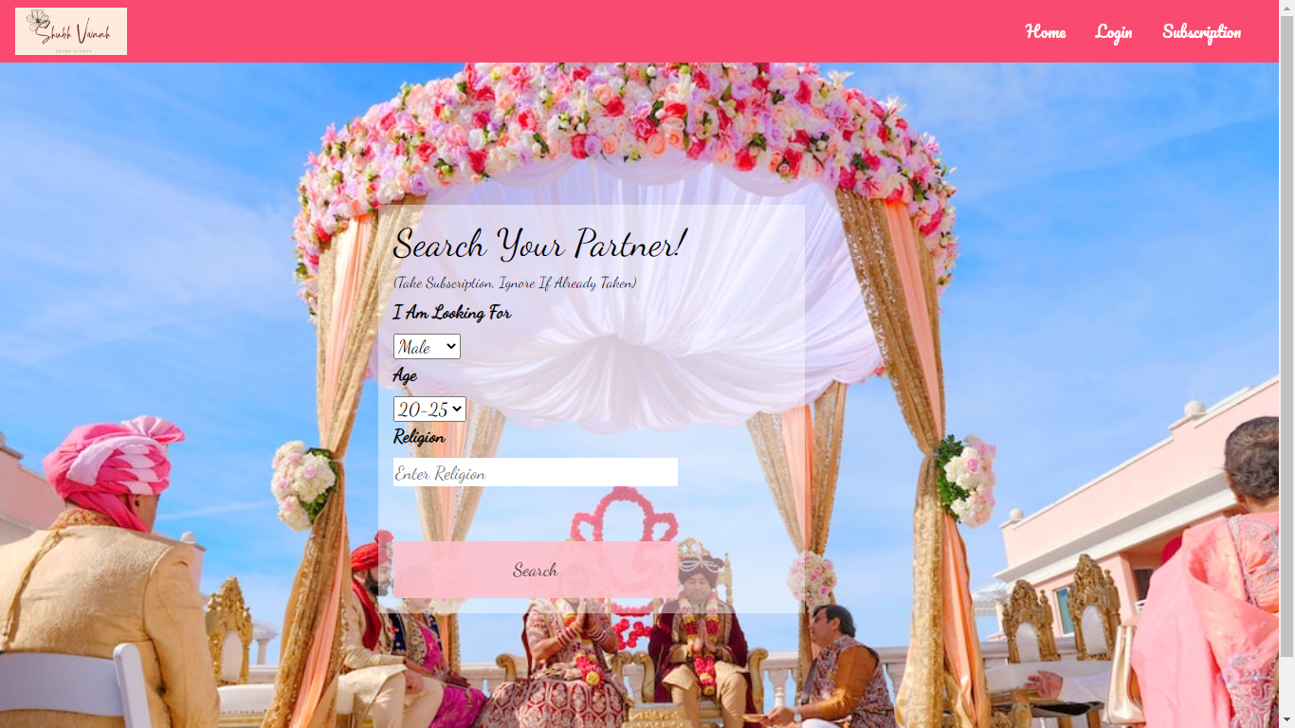
Select your match
Login Page
After login you will land on select your match page
Take package first if not taken subscription by clicking
subscription in navbar.
Selecting male as option shows male options and vice versa.

Slide 5
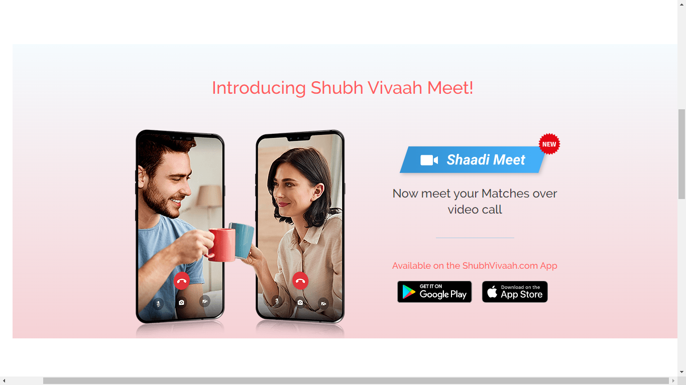
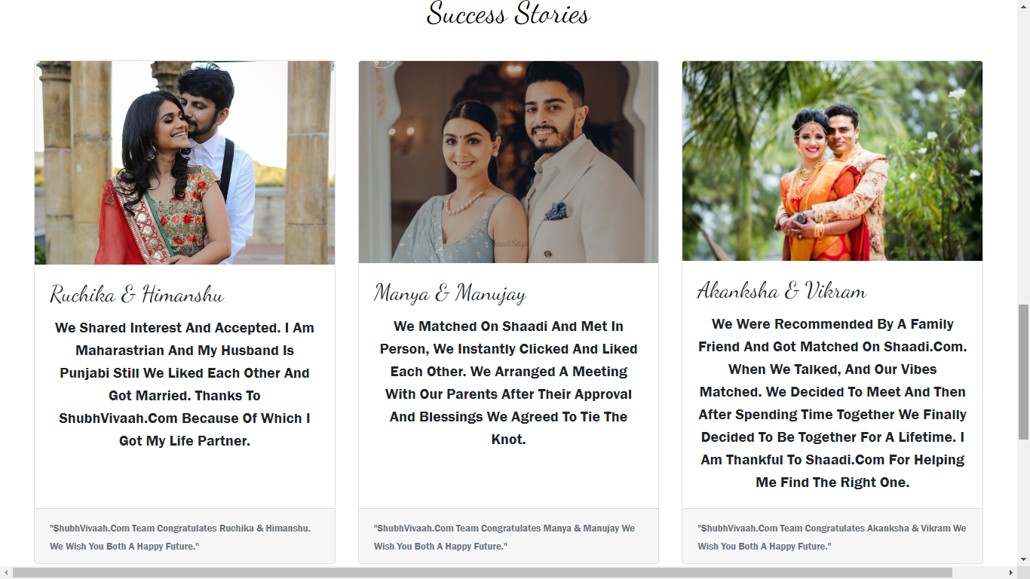
Success stories of Shubh Vivaah Matchmaking
New introduction of meet concept

Slide 6
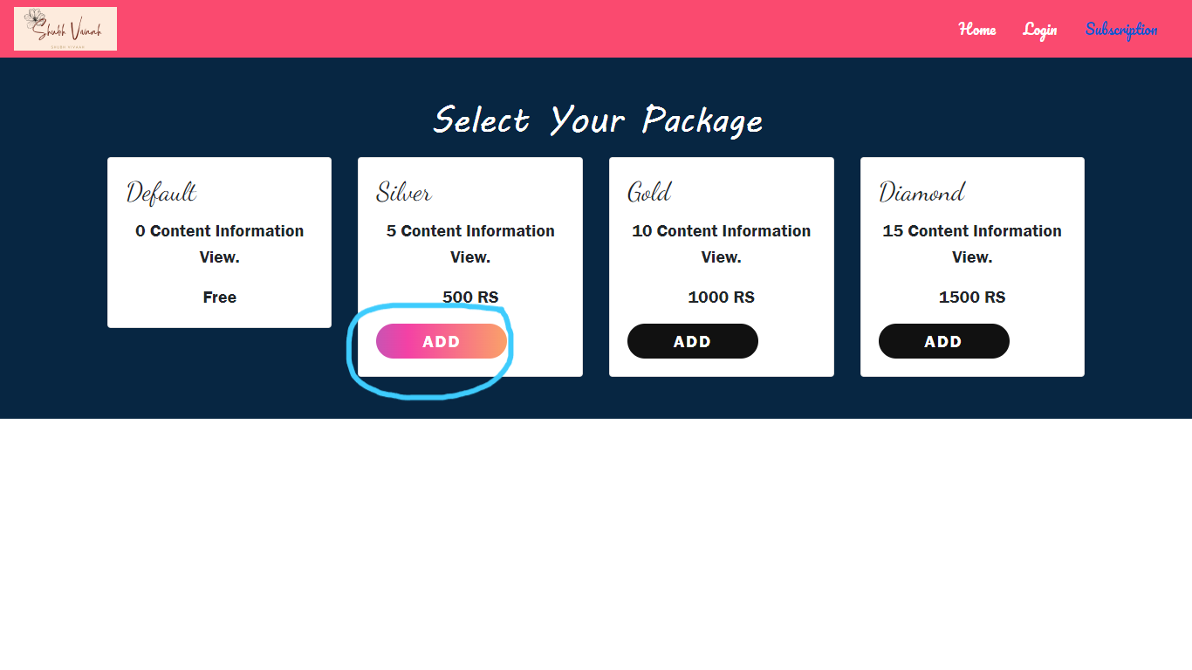
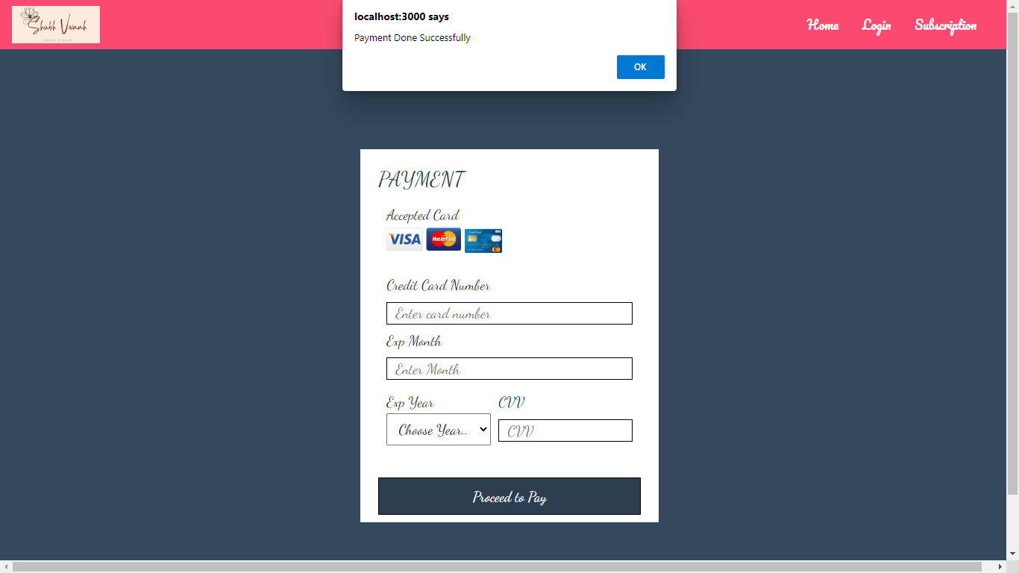
Subscription
Gradient button
On subscription select your package and accordingly 5 profiles will be displayed on taking Rupees 500 subscription, 10 on Rs.1000 and 15 on Rs.1500.We have done this using use state. We have also used a beautiful gradient button which shows animation on hover. On adding subscription proceeds on payment page where on clicking “Proceed to Pay” confirmation is displayed and alert to fill details if not filled.

Slide 7
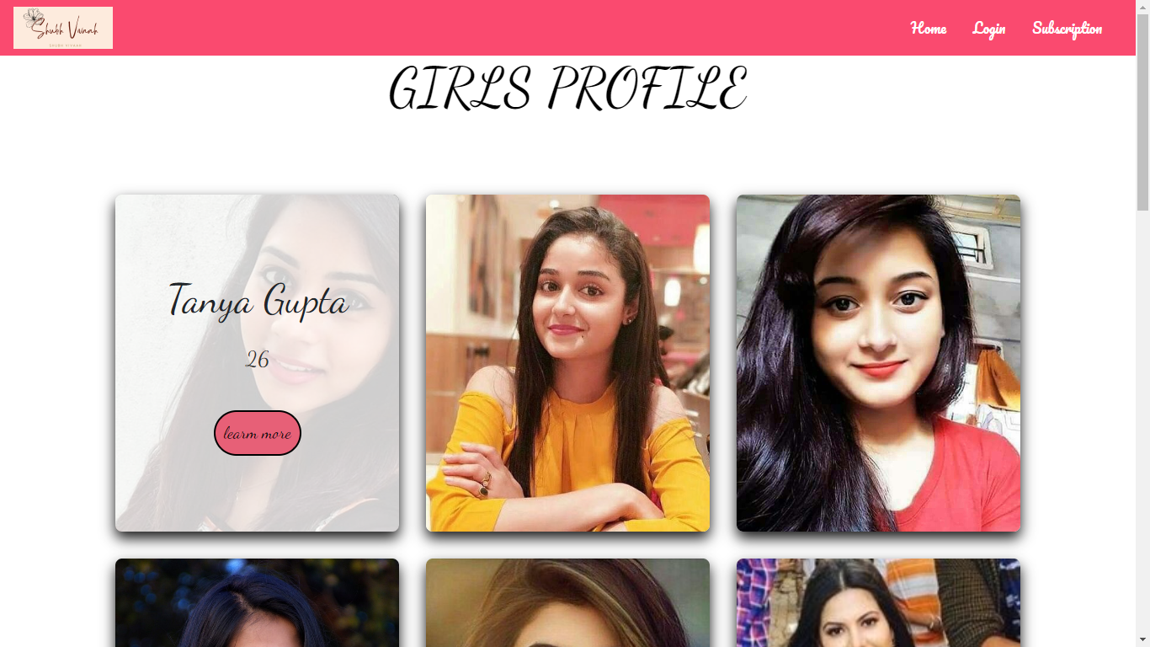
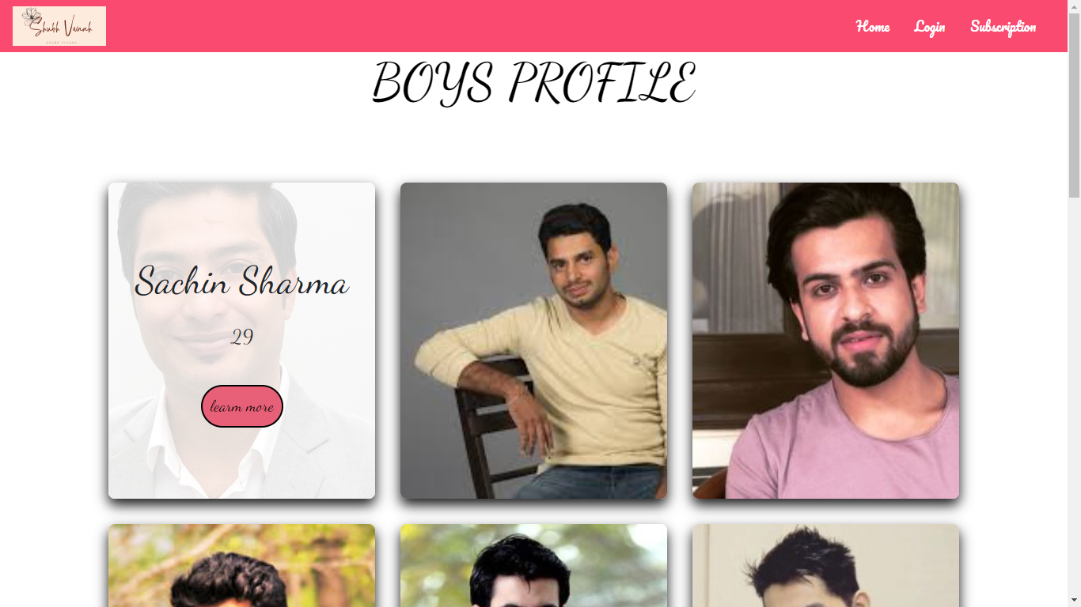
Boys profiles
Girls profiles
We have made these with the use of map function
On hover name and age is displayed and for further
details you need to click learn more.

Slide 8
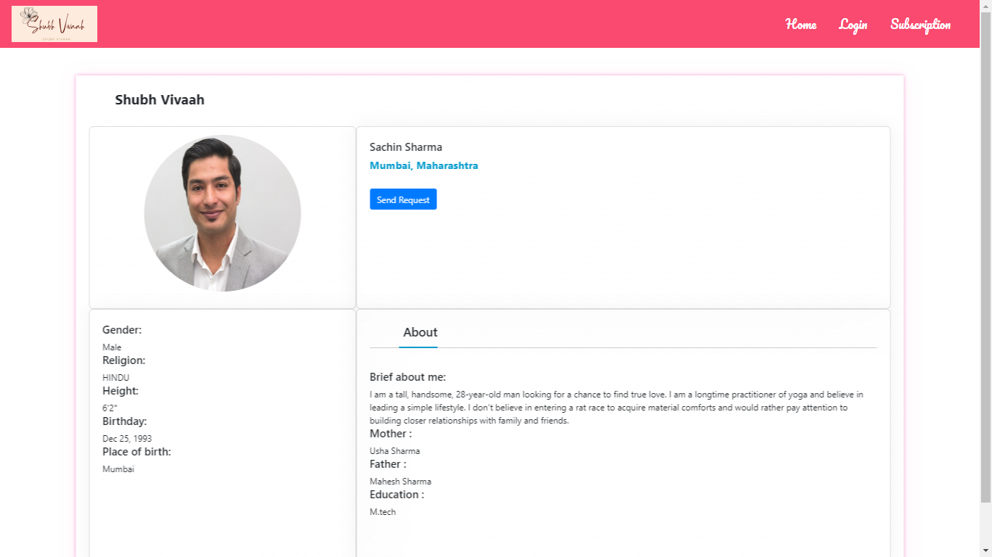
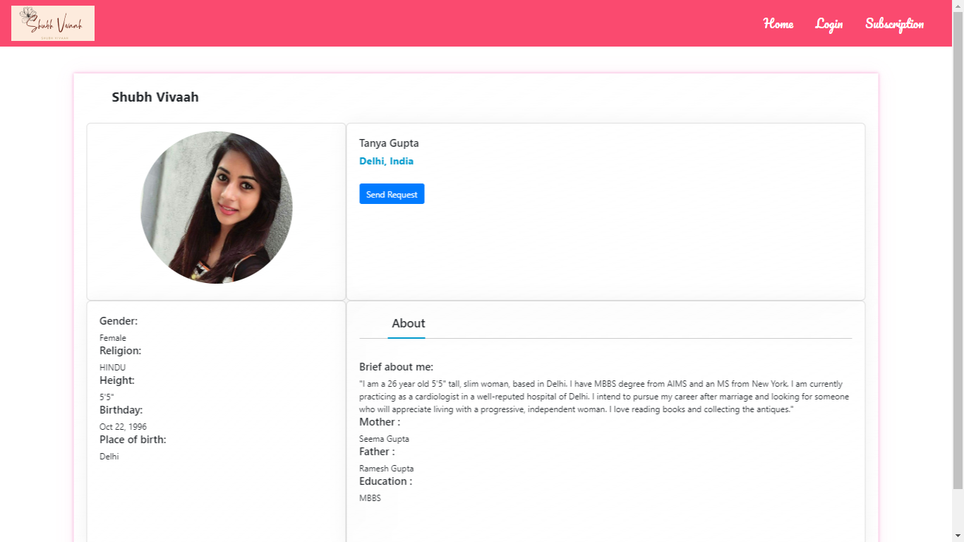
Profiles
On clicking learn more we land on persons profile
On clicking send request ,request is send to that person.

Slide 9
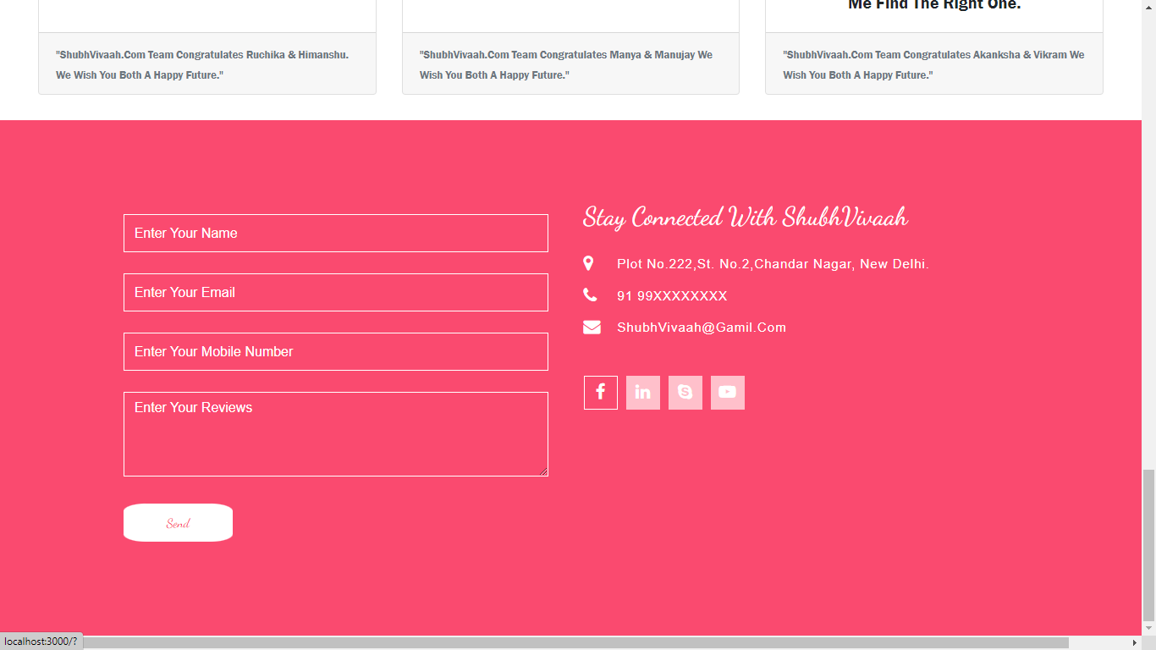
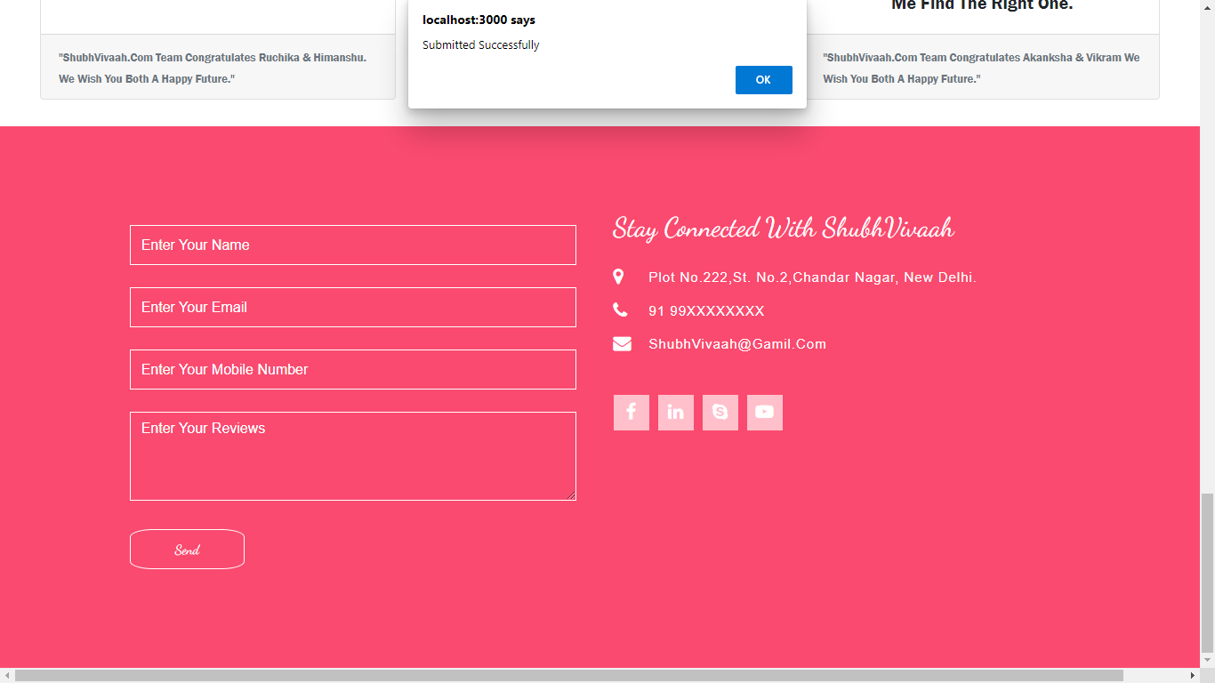
Reviews And contact details
Form to write reviews and favicons to visit social connect.
Alert to fill details if not filled and Confirmation
after form submitted successfully.

Slide 10


